Slide 1
CE 3372 Water Systems Design
pipeline HYDRAULICS examples : Part 1

Slide 2
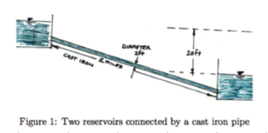
Example:
Repeat the flow between two reserviors, but change materials, include entrance and exit losses
K_{in} = ?
K_{exit} = ?
concrete

Slide 3
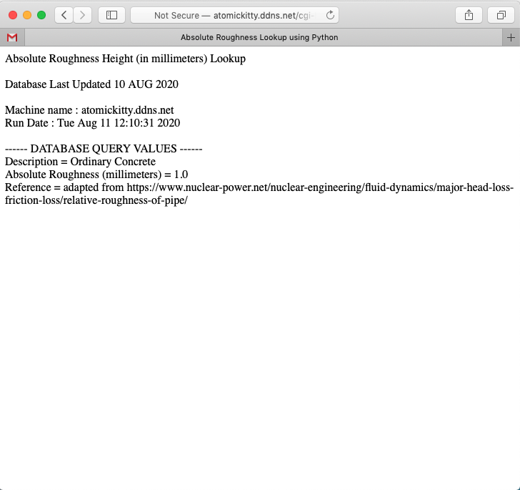
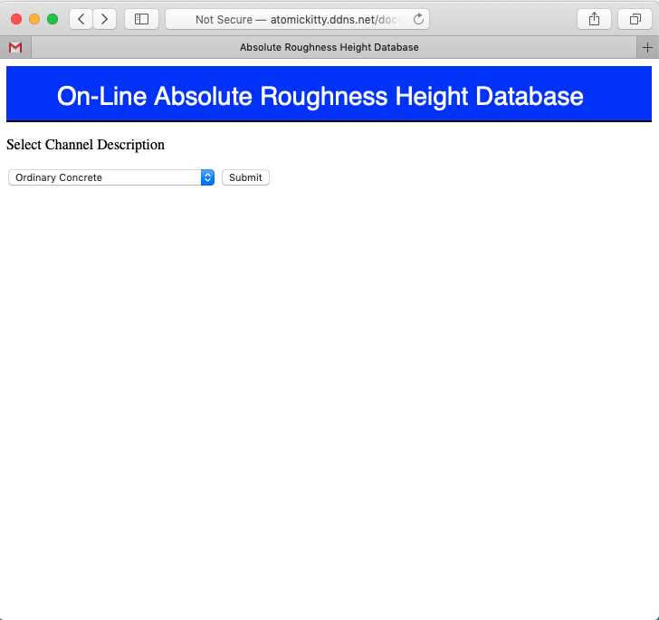
Example:
Determine roughness height for pipeline; k_{s} = 1.0mm

Slide 4
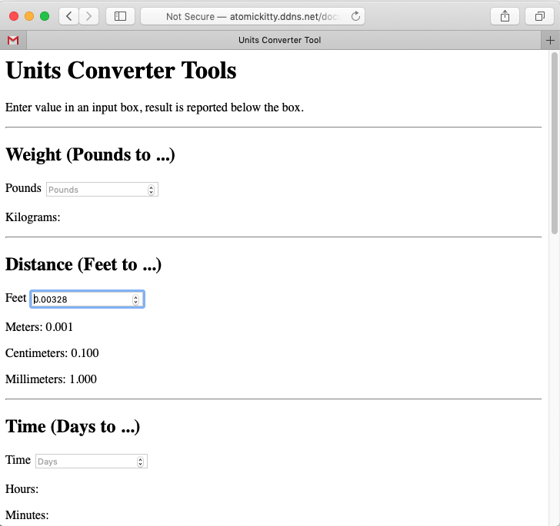
Example:
Convert millimeters to feet, k_{s} = 0.00328 ft

Slide 5
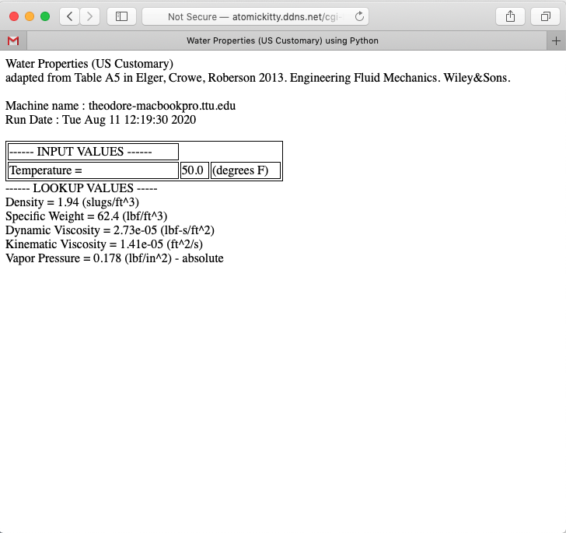
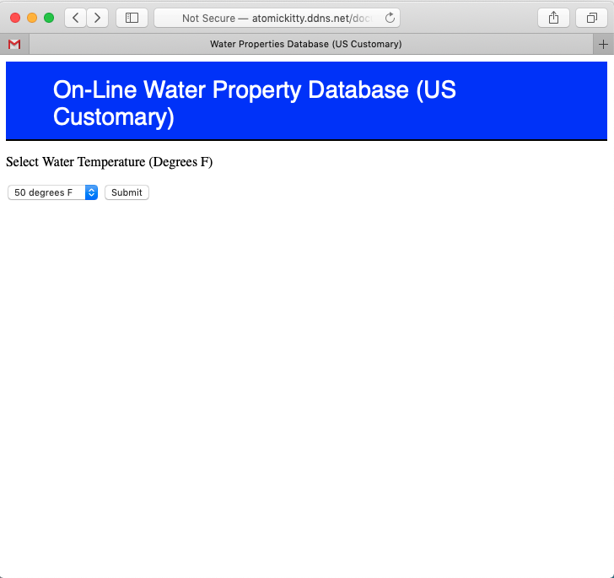
Example:
Water Properties

Slide 6
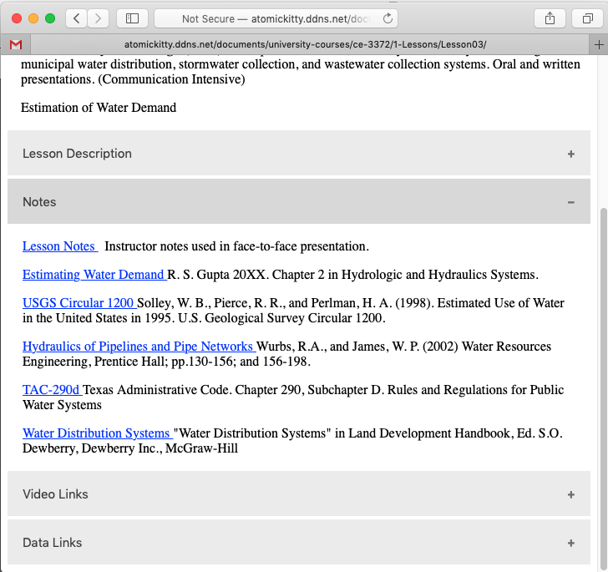
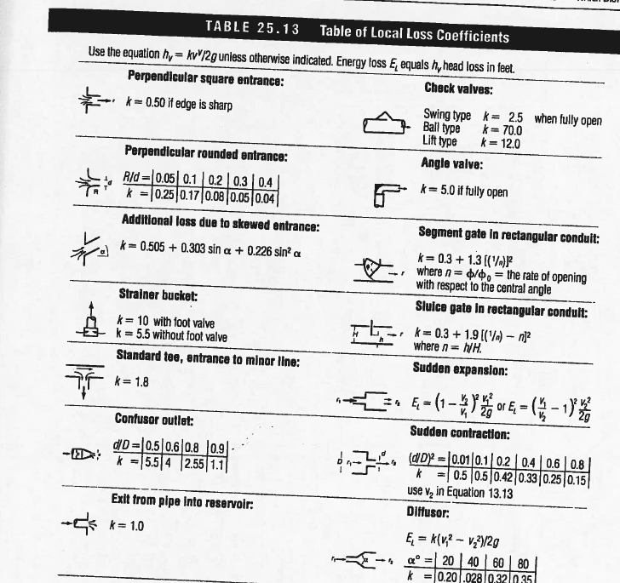
Example:
Minor Loss Coefficients
K_{in} = 0.5
K_{exit} = 1.0

Slide 7
Example:
Collect the various pieces of information:
Apply the JupyterLab tool, or online tool.
K_{in} = 0.5
K_{exit} = 1.0
Concrete:
k_{s} = 0.00328 ft
Kinematic Viscosity = 1.41e-05 (ft^2/s)

Slide 8
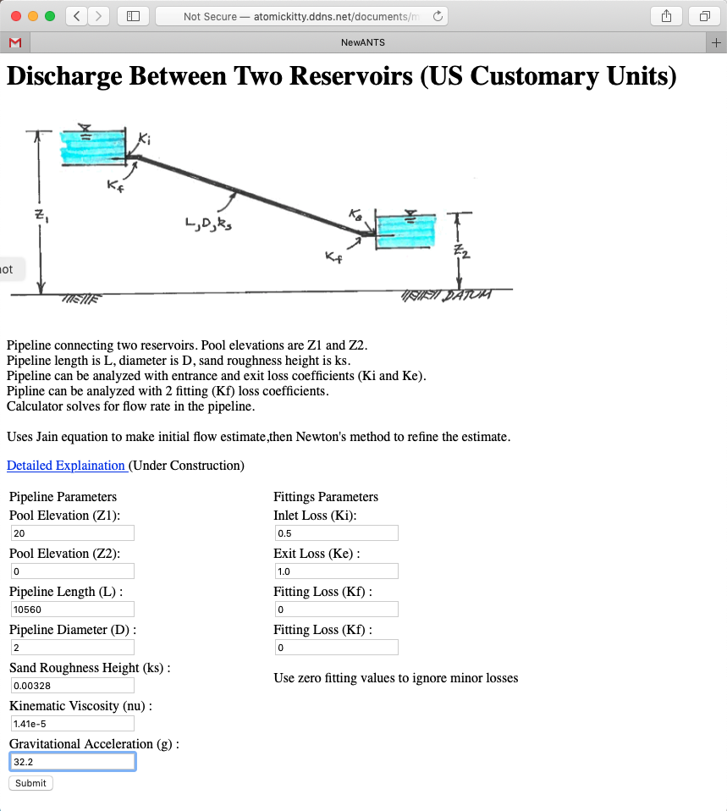
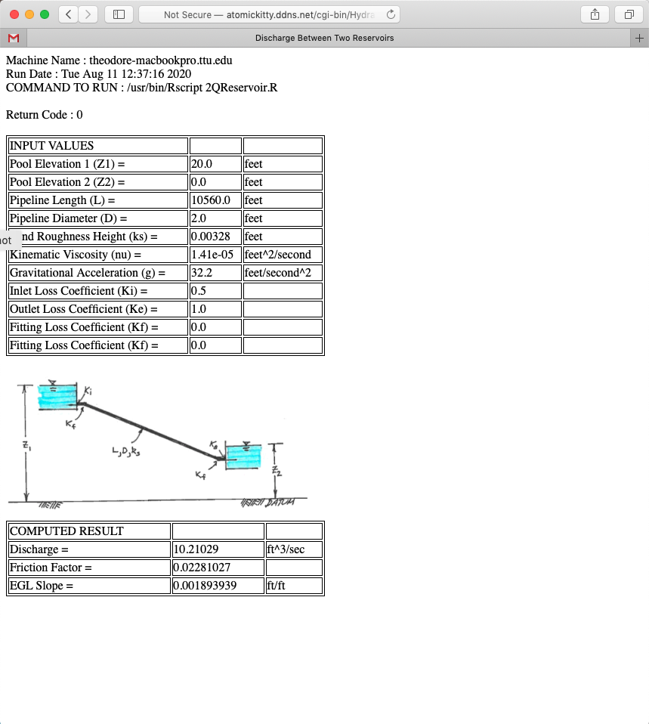
Example:
Online tool:

Slide 9
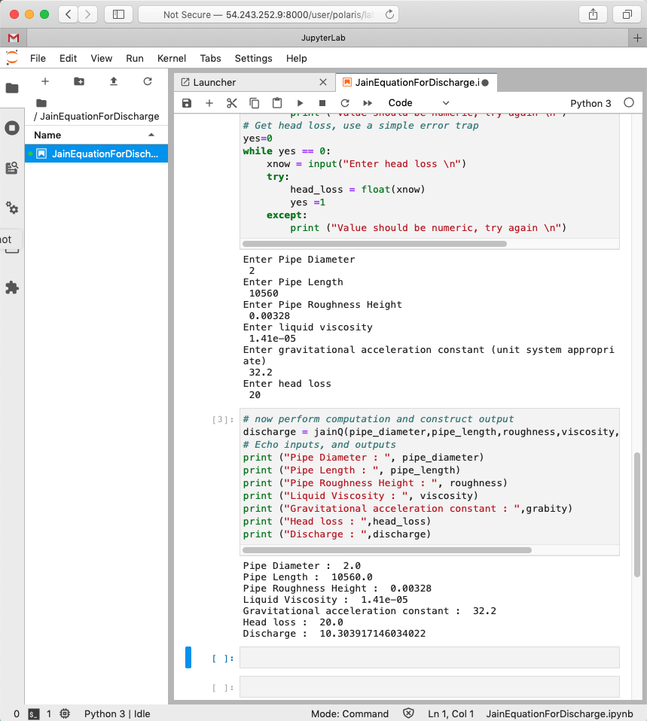
Example:
JupyterLab Notebook:
Nearly same result, Notebook did not account for entrance and exit losses

Slide 10
Linking systems
A hydraulic system can be analysed as a set of linked components to make an otherwise complicated system easier to analyze.
Idea is to break system into independent parts, analyze the parts then reassemble to answer questions about the whole system
Best illustrated by an example

Slide 11
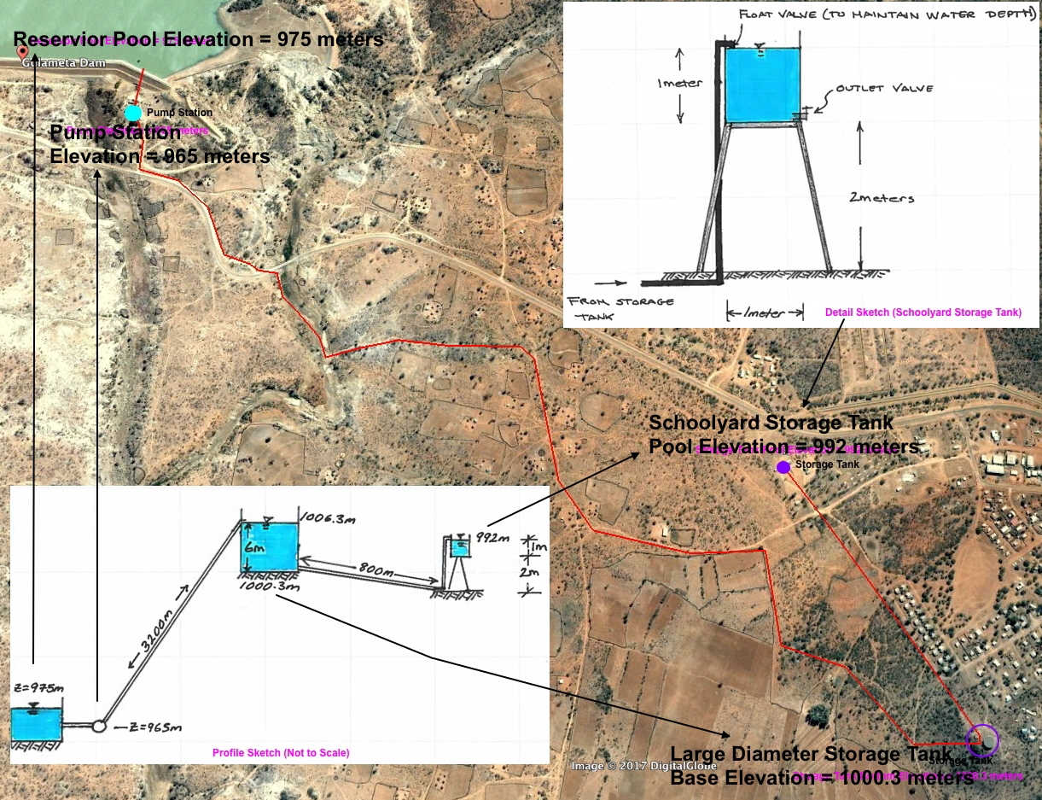
Linking systems
Notes:
The figure is an aerial image of a pipeline system with preliminary engineering sketches of the system (lower left panel) and a detail sketch of the terminal small storage tank (upper right panel). The 3,200 meter long pipeline lifts 25C water ( rho= 997 kg=m3,nu= 8.94 E-7 m2/s) from a treatment plant on the downstream face of Gulameta Dam through a 127 millimeter high-density polyethylene (HDPE) pipe (ks =0:0015 mm) to a large diameter at-grade cylindrical storage tank. A secondary, 800 meter long pipeline carries water from the large diameter storage tank to a small,
cylindrical (D = 1 meter), elevated storage tank at the village school. Both storage tanks have float valves to prevent overflow and maintain the indicated water poolelevations.

Slide 12
Linking systems
Analyze proposed system to determine anticipated behavior
Float valve fails at school
Outlet valve accidently left open
Pump operation under worst failure mode
Pump fails, time until system fails
Float valve limited
Oultet valve limited

Slide 13
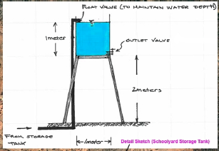
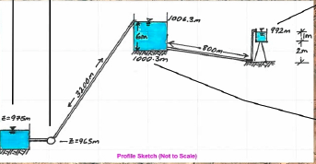
Linking systems
Float valve fails at school
Upstream head = 1006.3 m (pump working, supply tank stays full)
Downstream head = 992 m (pool elevation at schoolyard tank overflow)
Notes:
Assume the float valve at the schoolyard fails in the open position, and the schoolyard tank overows.
2 bends, K =1.5 each
1 inlet K =0.5
Upstream valve K =0.15
Float valve K = 70 (assume ball valve type)
127mm HDPE

Slide 14
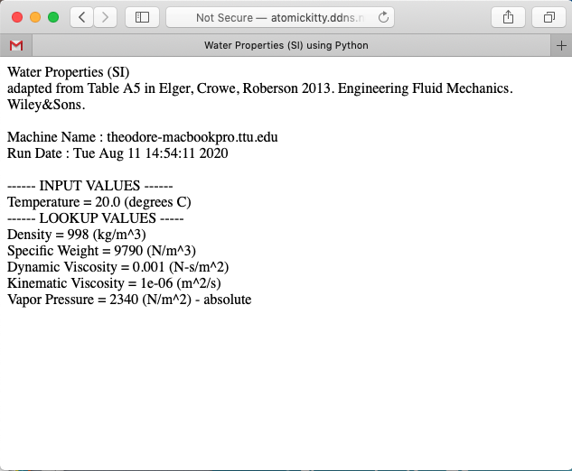
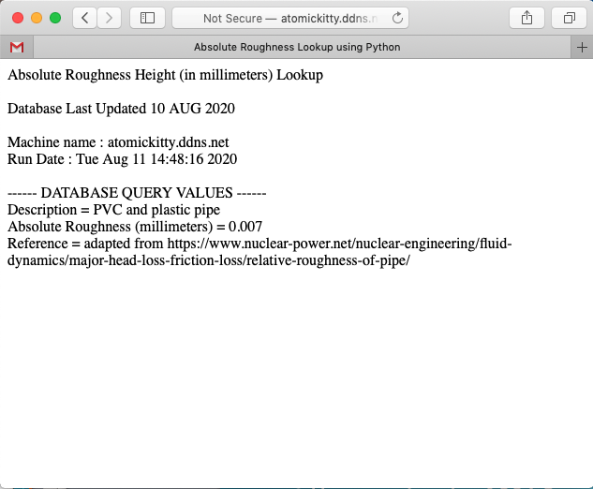
Linking systems
Float valve fails at school
Z₁= 1006.3 m ; Z₂ = 992 m
2 bends, K =1.5 each
1 inlet K =0.5
Upstream valve K =0.15
Float valve K = 70
Viscosity = 1.0 E-06sq.m/s
Ks (HDPE) = 0.007mm 0.000007m
Notes:
Assume the float valve at the schoolyard fails in the open position, and the schoolyard tank overows.
2 bends, K =1.5 each
1 inlet K =0.5
Upstream valve K =0.15
Float valve K = 70 (assume ball valve type)
127mm HDPE

Slide 15
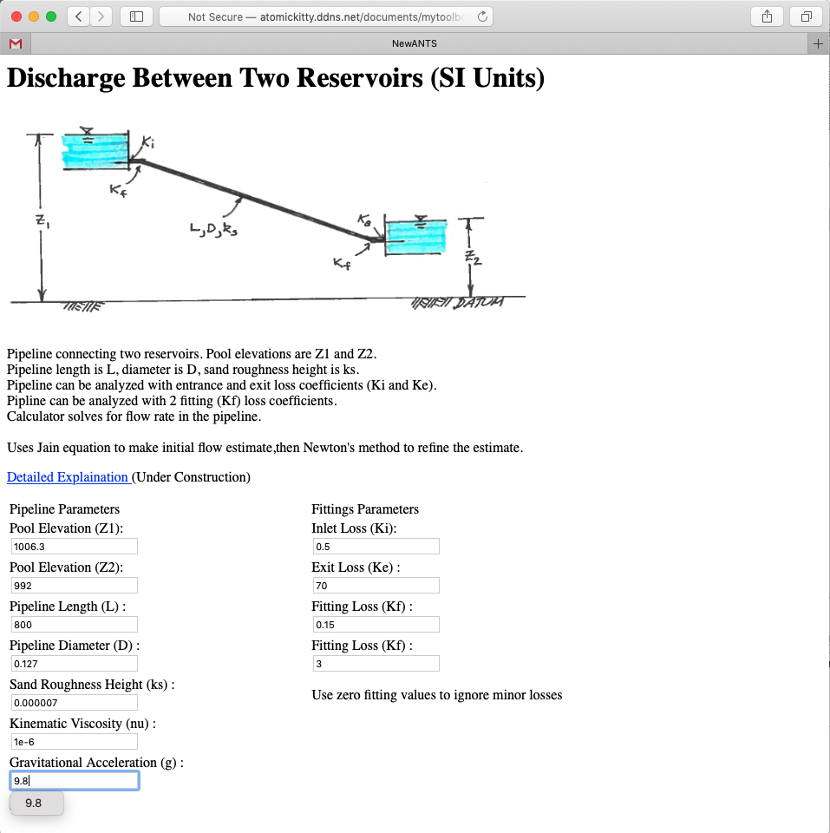
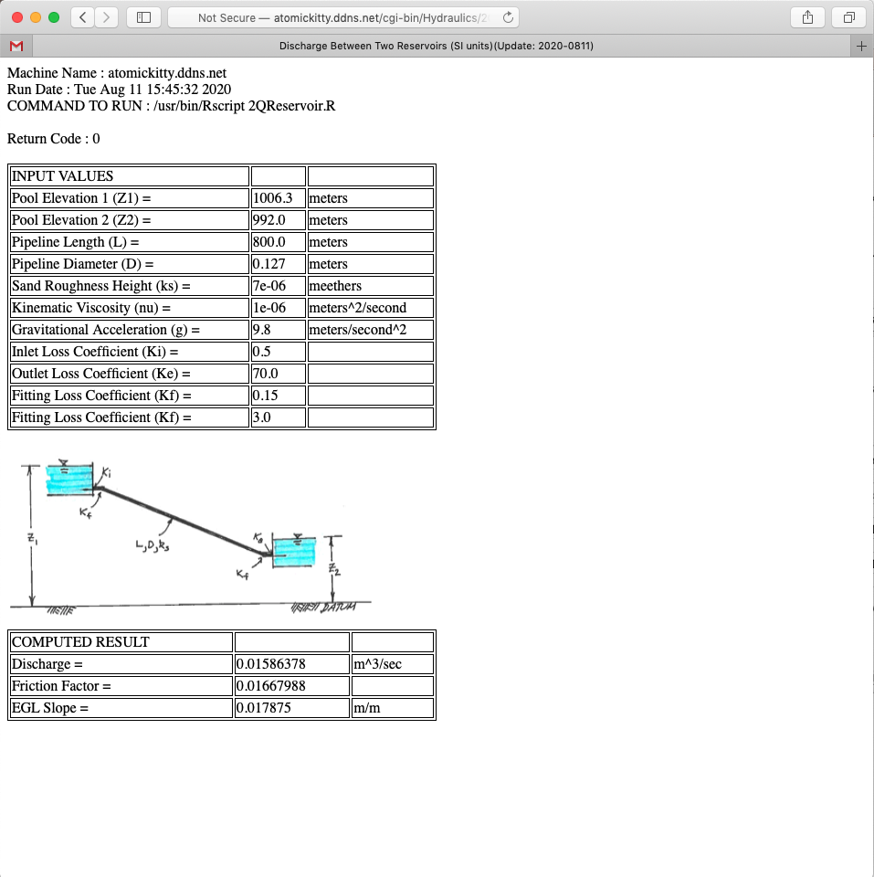
Linking systems
Hydraulic Model
~ 16 liters/second
Notes:
Assume the float valve at the schoolyard fails in the open position, and the schoolyard tank overows.
2 bends, K =1.5 each
1 inlet K =0.5
Upstream valve K =0.15
Float valve K = 70 (assume ball valve type)
127mm HDPE

